Slide 1
State Energy Conservation Award 2023
Kerala State Electricity Board Ltd
30.11.2023
Smt. Asha P A
Dy. Chief Engineer (Wind Project)
KSEBL Trivandrum

Slide 2
KSEB Ltd - Profile
State Transmission Utility & Distribution licensee which owns Generation Assets
Installed capacity of 3802 MW (incl. RE plants)
15000 km of Transmission network connecting 421 Substations
3.38 lakh km of Distribution network providing supply to 1.37 crore LT consumers, 7410 HT consumers and 66 EHT consumers
6 Training Centres

Slide 3
Kerala – Installed Capacity (MW)
Type | KSEB | IPP/CPP | Total
SHEP | 128 | 75 | 203
Wind | 2 | 69.2 | 71.2
Solar | 44.3 | 849.3 | 893.6
RE (excl. Large Hydro) | 174.3 | 993.5 | 1167.8 (30.7%)
Large Hydro | 1939 | - | 1939
RE (incl. Large Hydro) | 2113.3 | 993.5 | 3106.8 (81.7%)
Thermal | 160 | 536 | 696
Total | 2263.3 | 1529.5 | 3802.8

Slide 4
Solar – Year Wise Comparison
Year | Total Solar Capacity (MW) | Year-wise Increase (in %)
March 2019 | 150
March 2020 | 188 | 25.3
March 2021 | 293 | 55.9
March 2022 | 451 | 53.9
March 2023 | 765 | 69.6
November 2023 | 893

Slide 5
….. contd

Slide 6
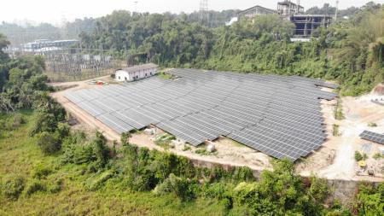
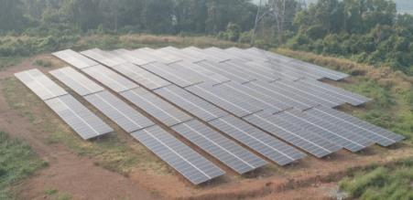
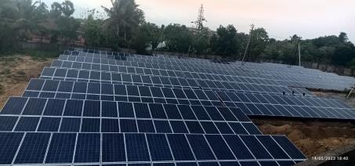
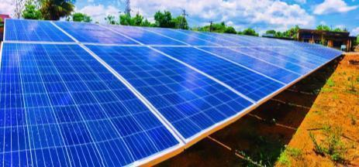
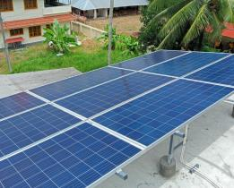
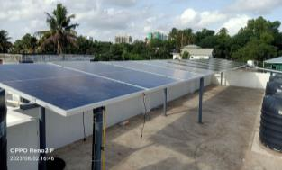
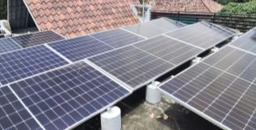
2.75 MW BRAHMAPURAM
0.25 MW KOZHINJAMPARA – PM KUSUM
SOURA Plants

Slide 8
Energy Conservation Projects
Nilaavu – LED Streetlight programme
Replacement of conventional streetlights with LED Streetlights
1.23 lakhs of 18W LEDs
1.09 lakhs of 35W LEDs
9046 Nos of 70W LEDs
9120 Nos of 110W LEDs
Filament Free Kerala
4 lakh LED lamps distributed during 2022-23
Cumulative – 1.15 Crore LED lamps distributed for 14.7 lakh consumers
Urjjam Karuthi Vekkam Nalekku programme
Promotion of Energy Conservation among public – prizes to consumers who reduce consumption
3880 domestic consumers and 140 industrial consumers were awarded prizes along with mass campaigns on National Energy Conservation Day 2022 NationalEnergyConservationDay_UrjamKVN_Report.pdf

Slide 9
Energy Conservation Measures in Network
Particulars | Quantum | Project Cost (Rs in Crore)
Installation of Star rated transformers | 1308 (Nos) | 42.9
Replacement of old transformers with new star rated transformers | 500 (Nos) | 12.23
Reconductoring in LT network | 16905 (km) | 80.95
Reconductoring in HT network | 817 (km) | 7.2
Conversion of Single phase to Three phase | 1237 (km) | 36.3

Slide 10
RE Projects commissioned
KSEBL Owned Plants
2.75 MW Ground mounted Solar plant at Brahmapuram (Rs 14.77 Crore)
12.1 MW Rooftop Solar plants at 814 locations under Soura Project (Rs 57.8 Crore)
0.7 MW ground mounted Solar plants at 5 locations (Rs 3.98 Crore)
EV Fast Charging Stations – at 56 locations (Rs 14.14 Crore)
Pole mounted Charging Stations – at 1140 locations (Rs 3.18 Crore)

Slide 11
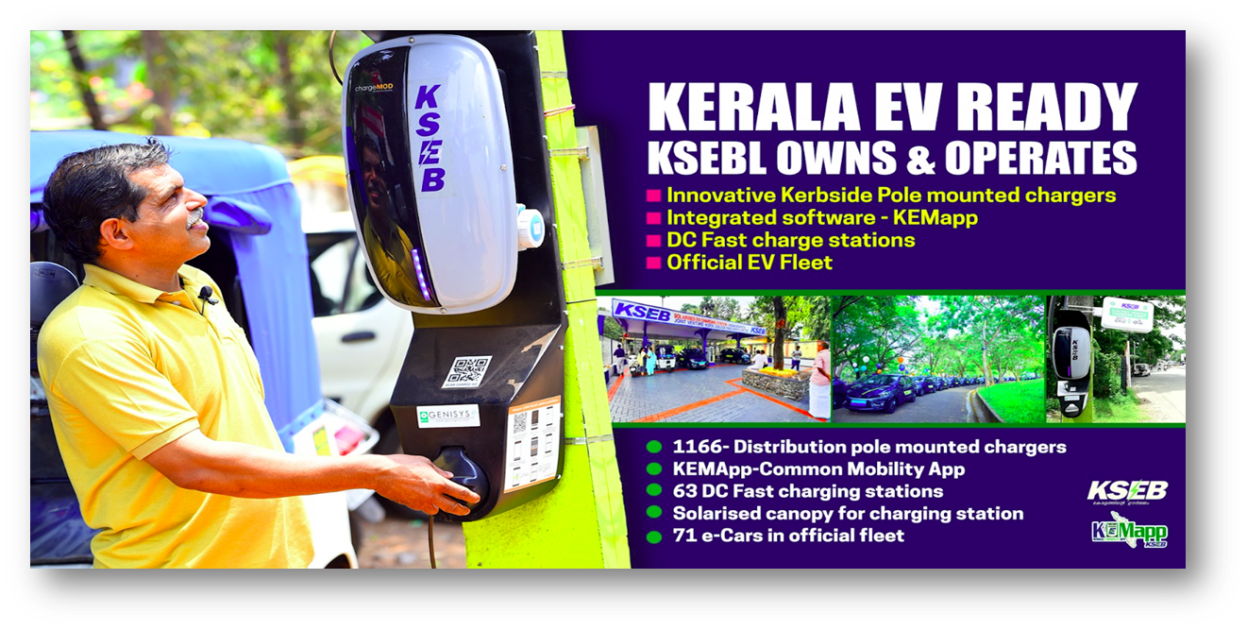
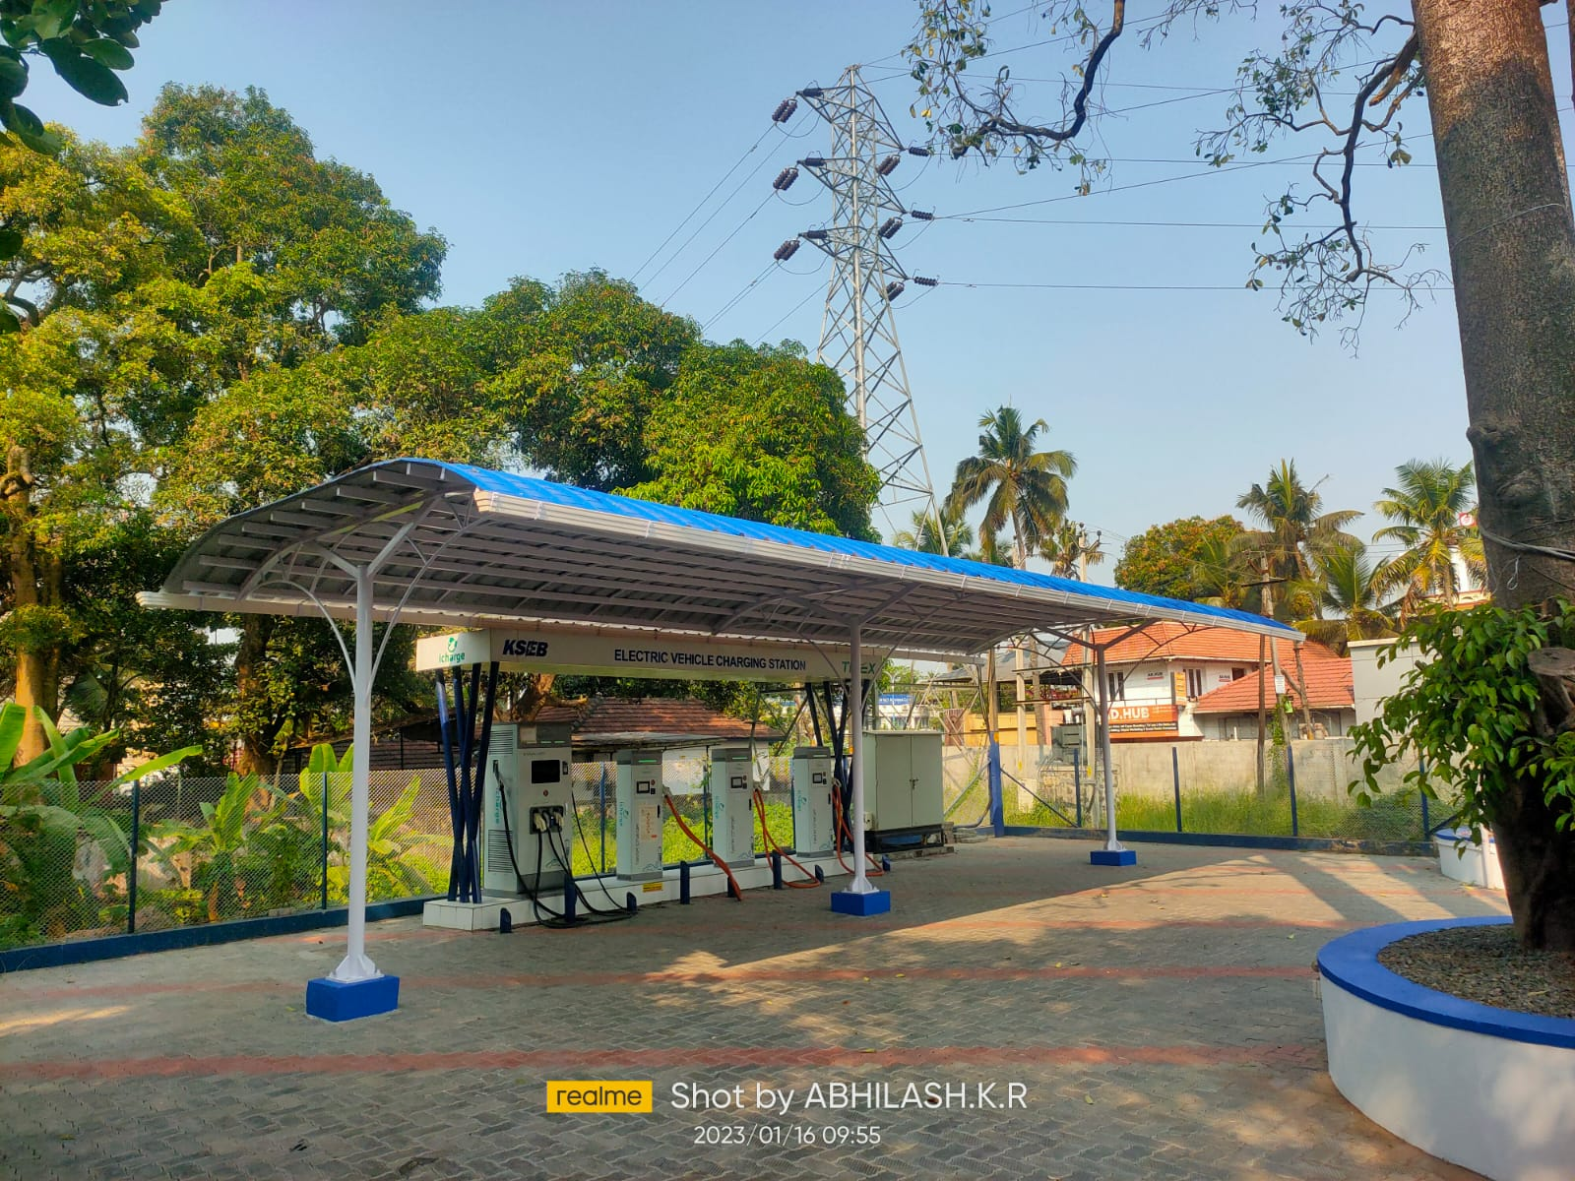
KSEB as SNA for EVCI

Slide 12
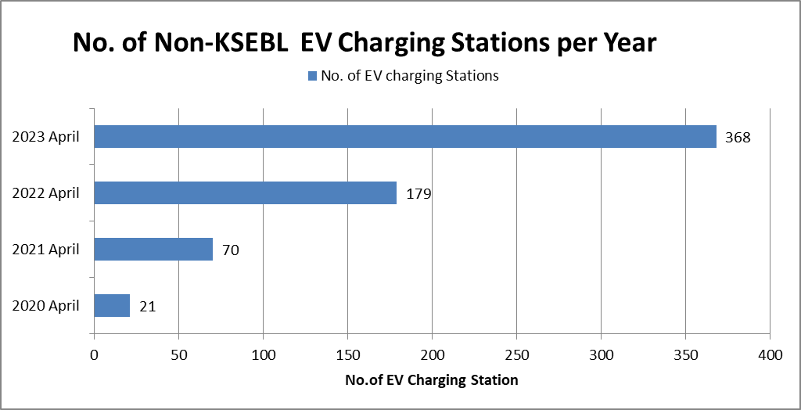
Non-KSEBL EVCS

Slide 13
…. contd
KSEBL as Implementing Agency
110.47 MW Rooftop Solar plants at 29295 locations (Rs 663 Crore)
0.5 MW Rooftop Solar plants at 23 locations of Govt. Institutions (Rs 3.1 Crore)
3 EV Fast Charging Stations under Chittur Municipality (Rs 35 lakhs)
19 EV Pole mounted Charging Stations under Cochin Municipality (Rs 6.1 lakhs)

Slide 14
RE Projects under Implementation phase
24.8 MW Rooftop Solar plants at 6347 locations under Soura scheme (Rs 148.6 Crore)
10.3 MW Ground mounted Solar plants at 9 locations under PM KUSUM Component C (Rs 58.5 Crore)
1.8 MW Rooftop Solar plants at 100 locations under various institutions (Rs 11 Crore)

Slide 15
Additional Statistics
T & D Loss Reduction from 10.19 % to 9.27% in 2022-23
Distributed Solar Plants spread across 45% of 96000 DTRs
Particulars | Energy Generation / Consumption / Savings (MU) | CO₂ reduction (metric Ton)
RE Generation | 1929 | 1639650
EV Charging Stations | 0.45 | 753
Nilaavu | 67.6 | 57448
FFK | 18.36 | 15605
UKVN (Shortlisted only) | 23.22 | 19737

Slide 16
Thank You

